Slide 1
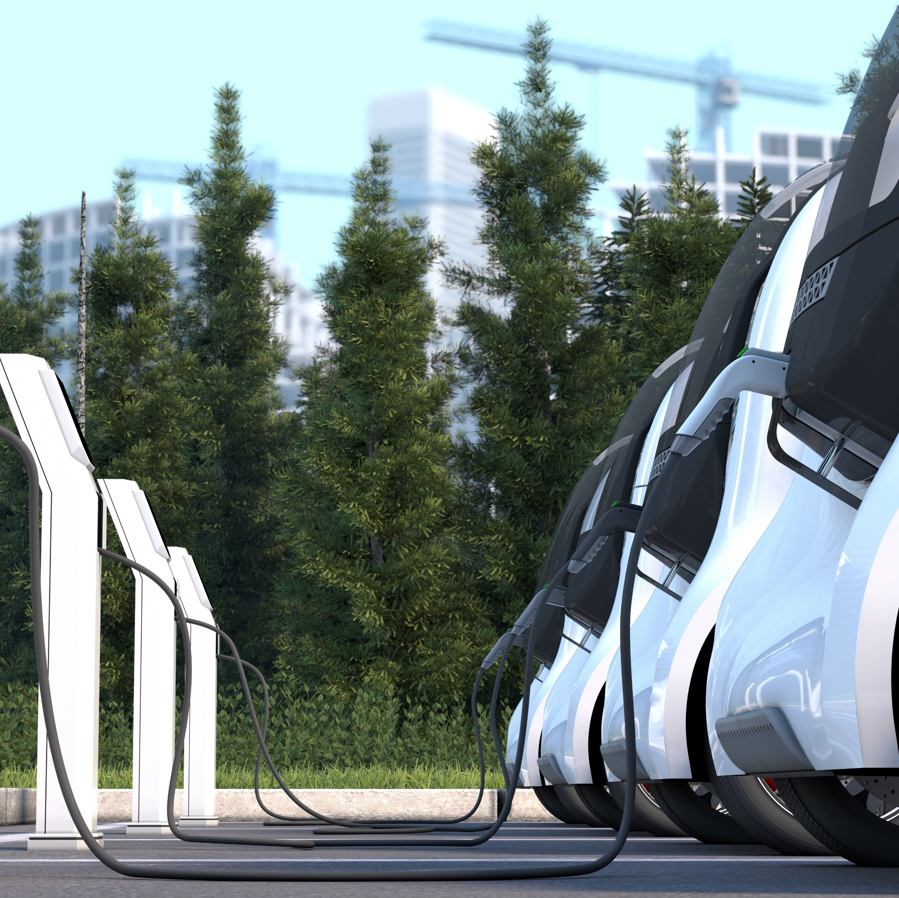

WBCSD Charging infrastructure value framework
EVI Pilot City Forum
9th November 2021
Thomas Deloison
Director, Mobility, WBCSD

Slide 2

World Business Council for Sustainable Development (WBCSD)
WBCSD is a global, CEO-led organization of 200 forward thinking businesses working together to accelerate the transition to a sustainable world.
Our vision is to create a world where more than nine billion people are all living well and within the boundaries of our planet, by 2050.
GLOBAL
UNIQUE BUSINESS PLATFORM
CEO-LED
MARKET-DRIVEN
Notes:
WBCSD is oriented towards collective action and led by our member company CEOs.
We consider sustainable development as a strategic business opportunity. We strive to make more member companies more competitive.
Our members enjoy access to a diverse business community across sectors and a safe space to exchange ideas, know - how and information with peers. Together, we develop business solutions to global challenges that no single company can tackle alone.

Slide 3
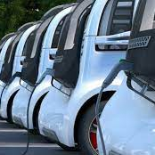
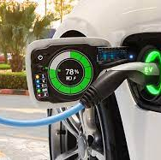


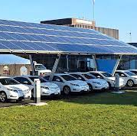
Pathway to decarbonized transport
Bringing business together to bridge the technology and investment gap to net-zero light-duty transport
Scaling to 100% EV fleets requires:
equally fast deployment of sustainable and inclusive charging infrastructure
Cross-sectoral collaboration is needed to ensure efficient energy, transport and real-estate integration
OEMs &
Fleet
operators
Charging
Technology
providers
Utilities
Real-estate
Notes:
Example with 3 program areas

Slide 4












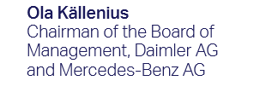



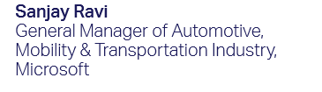


Charging infrastructure Value Framework
Ensuring TIMELY, INCLUSIVE, SUSTAINABLE transition
Collaboration across the value chain
Andrian Cainarean
Head of Mobility Partnerships and Energy Transition
Craig McDonnell
Senior Vice President and General Manager, Energy Transition & Digital, EMEA EATON
Miguel Stilwell d’Andrade CEO of EDP
Full Document Release: 10 Nov at 11h GMT
Businesses bridging the technology and
infrastructure gap to net-zero mobility
4

Slide 5



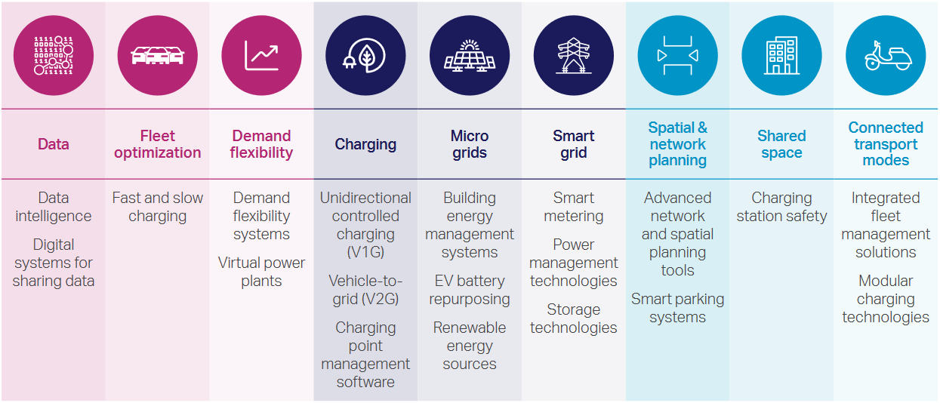
Businesses agreeing on key enabling technologies

Slide 6
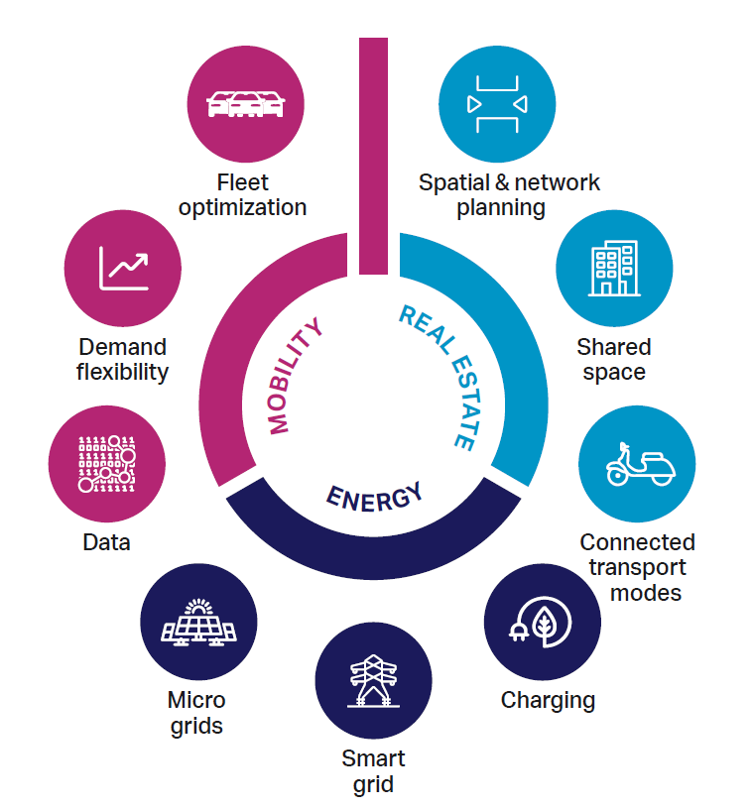
Providing nine key actions to unlock shared value
6

Slide 7

Engaging businesses with local governments
Exchange knowleadge on best practices to feed locally-informed framework for business action
Innovate on business models and financing mechanisms to accelerate private investment in infrastructure
Explore technology solutions and identify deployment roadmaps for the heavy-duty vehicle segment

Slide 8
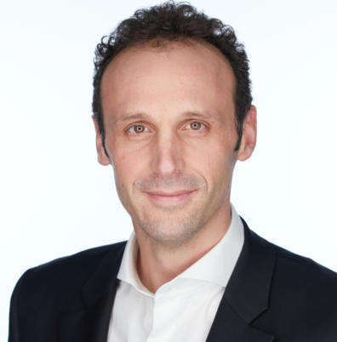
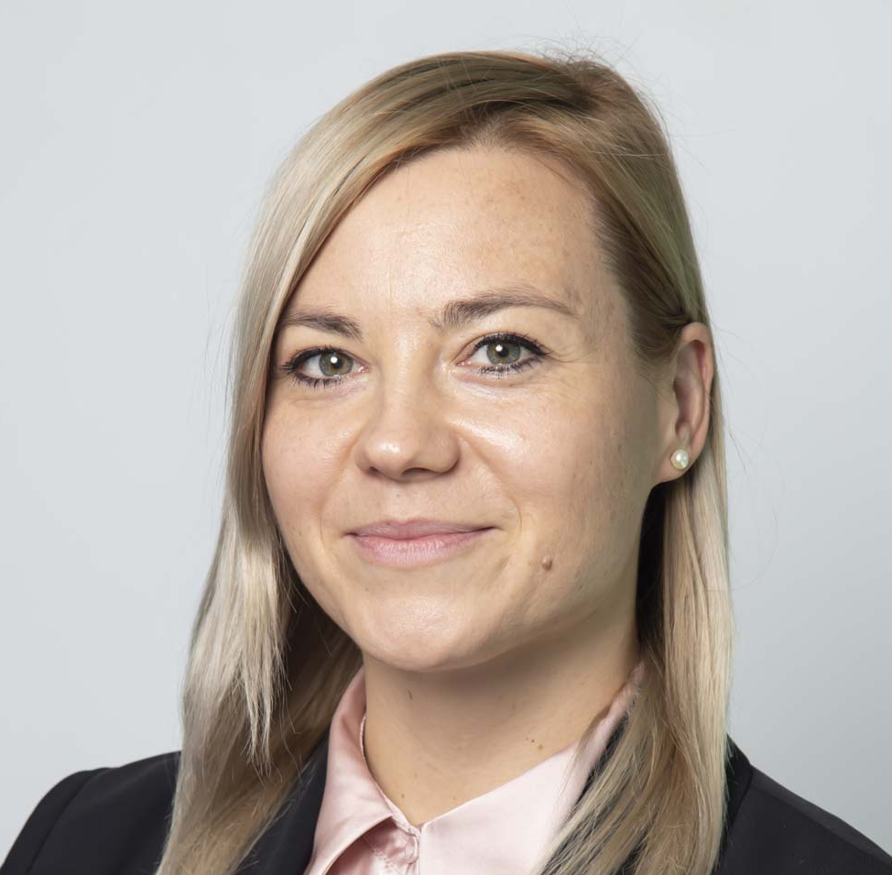
Connect with us
Thomas Deloison
Director, Mobility
Deloison@wbcsd.org
Urska Skrt
Manager, Mobility
Urska.skrt@wbcsd.org

Slide 9


Geneva, Beijing, Delhi, London, New York, Singapore

